Slide 1
DISCRETE STRUCTURES
CHAPTER 2 PART 1
RELATIONS

Slide 2

Definition
Let A and B be two sets.
A binary relation, or simply a relation R from set A to set B is a subset of the cartesian product A x B
If , we say a is related to b by R
write as a R b ( a R b ↔ (a,b)∈R )

Slide 3
Example 1
Let A= { 1, 2, 3, 4 } and B= { p, q, r }
R = { (1, q), (2, r), (3, q), (4, p) }
R ⊆ A×B
R is the relation from A to B
1Rq ( 1 is related to q)
3Rp ( 1 is not related to p)

Slide 4
Relations
Binary relations: xRy
On sets x∈X y∈Y R ⊆ X×Y
Example:
“less than” relation from A={0,1,2} to B={1,2,3}
Use traditional notation
0 < 1, 0 < 2, 0 < 3, 1 < 2, 1 < 3, 2 < 3
Or use set notation
A×B={(0,1),(0,2),(0,3),(1,1),(1,2),(1,3),(2,1),(2,2),(2,3)}
R={(0,1),(0,2),(0,3), (1,2),(1,3),(2,3)}
Or use Arrow Diagrams

Slide 5
Arrow Diagram
0
1
1
2
2
3
R={(0,1),(0,2),(0,3), (1,2),(1,3),(2,3)}

Slide 6
Example 2
A = {New Delhi, Ottawa, London, Paris, Washington}
B = {Canada, England, India, France, United States}
Let x∈A, y∈B.
Define the relation between x and y by “x is the capital of y ”
R = {(New Delhi, India), (Ottawa, Canada), (London, England), (Paris, France), (Washington, United States)}

Slide 7

Definition
If R is a relation from set A into itself, we say that R is a relation on A.
a∈A, b∈A (a,b)∈A×A and R⊆ A×A
Example
Let A = (1,2,3,4,5) and R be defined by a,b∈A,
R = {( 1,3),(2,4),(3,5)}

Slide 8
Exercise 1
Write the relation R as (x,y)∈R
(i) The relation R on {1, 2, 3, 4} defined by (x,y)∈R if x²≥y
(ii) The relation R on {1, 2, 3, 4, 5} defined by (x,y)∈R if 3 divides x-y

Slide 9
Domain and Range
Let R, a relation from A to B.
The set, { a∈A | (a,b) ∈ R for some b∈B }
is called the domain of R.
The set, { b∈B | (a,b) ∈ R for some a∈A }
is called the range of R.

Slide 10
Example 3
Let R be a relation on X = {1, 2, 3, 4}
defined by (x,y)∈ R if x ≤ y, and x,y ∈ X.
Then,
R = {(1,1), (1,2), (1,3), (1,4), (2,2), (2,3),
(2,4), (3,3), (3,4), (4,4)}
The domain and range of R are both
equal to X.

Slide 11
Example 4
Let X = {2, 3, 4} and Y = {3, 4, 5, 6, 7}
If we define a relation R from X to Y by,
(x,y) ∈ R if y/x (with zero remainder)
We obtain,
R = { (2,4), (2,6), (3,3), (3,6), (4,4) }
The domain of R is {2,3,4}
The range of R is {3,4,6}

Slide 12
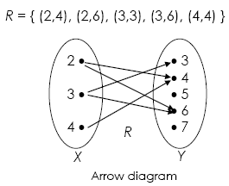
Example 4(cont)

Slide 13
Exercise 2
Find range and domain for:
(i) The relation R={(1,2), (2,1), (3,3), (1,1), (2,2)} on X={1, 2, 3}
(ii) The relation R on {1, 2, 3, 4} defined by (x,y)∈R if x²≥y

Slide 14
Diagraph
An informative way to picture a relation on a set is to draw its digraph.
Let R be a relation on a finite set A.
Draw dots (vertices) to represent the elements of A.
If the element (a,b)∈ R, draw an arrow (called a directed edge) from a to b

Slide 15
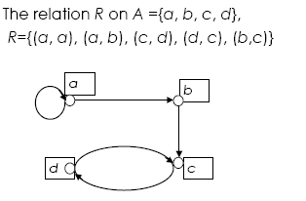
Example 5

Slide 16
Example 6
Let
A = { 1,2,3,4} and
R = { (1,1), (1,2), (2,1), (2,2), (2,3), (2,4), (3,4) , (4,1)}
Draw the digraph of R

Slide 17
Digraph
2
1
3
4

Slide 18
Find the relation determined by digraph below
Example 7
2
1
3
4
Since a_{i} R a_{j} if and only if there is an edge from a_{i} to a_{j}, so
R = { (1,1), (1,3), (2,3), (3,2), (3,3), (4,3)}

Slide 19
Exercise 3
Draw the diagraph of the relation.
(i) R = {(a,c),(b,b),(b,c)}
(ii) The relation R on {1, 2, 3, 4} defined by (x,y)∈R if x²≥y

Slide 20
Exercise 4
Write the relation as a set of ordered pair.
b
a
d
c

Slide 21
Matrices of Relations
A matrix is a convenient way to represent a relation R from A to B.
  Label the rows with the elements of A (in some arbitrary order)
  Label the columns with the elements of B (in some arbitrary order)

Slide 22

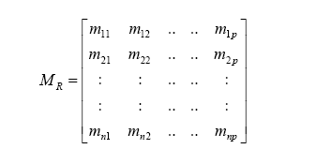
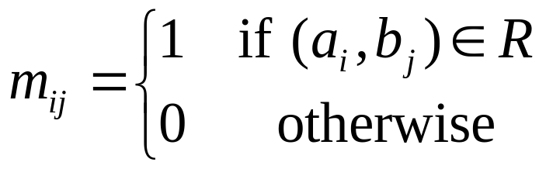
Matrices of Relations
Let be the Boolean n x p matrix

Slide 23
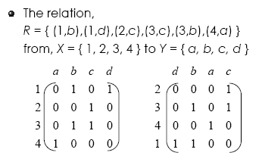

Example 8
or

Slide 24
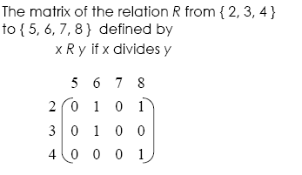
Example 9

Slide 25
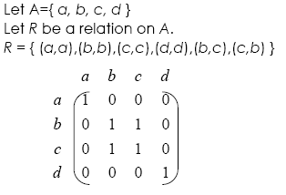
Example

Slide 26
Example 10
An airline services the five cities c₁, c₂, c₃, c₄ and c₅. Table below gives the cost (in dollars) of going from c_{i} to c_{j}. Thus the cost of going from c₁ to c₃ is RM100, while the cost of going from c₄ to c₂ is RM200
To from | c₁ | c₂ | c₃ | c₄ | c₅
c₁ |  | 140 | 100 | 150 | 200
c₂ | 190 |  | 200 | 160 | 220
c₃ | 110 | 180 |  | 190 | 250
c₄ | 190 | 200 | 120 |  | 150
c₅ | 200 | 100 | 200 | 150

Slide 27
If the relation R on the set of cities
A = {c₁, c₂, c₃, c₄, c₅} : c_{i} R c_{j} if and only if the cost of going from c_{i} to c_{j} is defined and less than or equal to RM180.
i) Find R.
ii) Matrices of relations for R

Slide 28

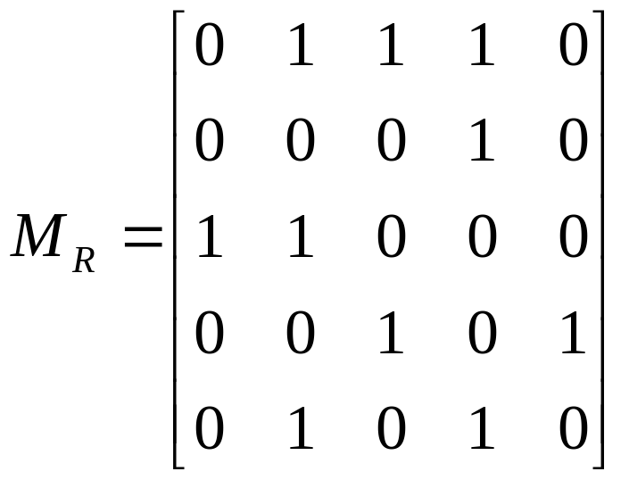
R = {(c₁,c₂), (c₁,c₃), (c₁,c₄), (c₂,c₄),(c₃, c₁), (c₃,c₂), (c₄,c₃), (c₄,c₅), (c₅,c₂), (c₅,c₄)}

Slide 29
Exercise 5
Let A = {1, 2, 3,4} and R is a relation from A to A.
Suppose R = {(1,2), (1,3), (1,4), (2,3), (2,4) , (3,4)}
What is R (represent)?
What is matrix representation of R?

Slide 30

Let A = {1, 4, 5} and let R be given by the digraph shown below. Find M_{R} and R
1
4
5

Slide 31
In degree and out degree
If R is a relation on a set A and aϵA, then the in-degree of a (relative to relation R) is the number of bϵA such that (b,a)ϵR.
The out degree of a is the number of bϵA such that (a,b)ϵR.
Meaning that, in terms of the digraph of R, is that
the in-degree of a vertex is
“the number of edges terminating at the vertex”
The out-degree of a vertex is
“ the number of edges leaving the vertex”

Slide 32
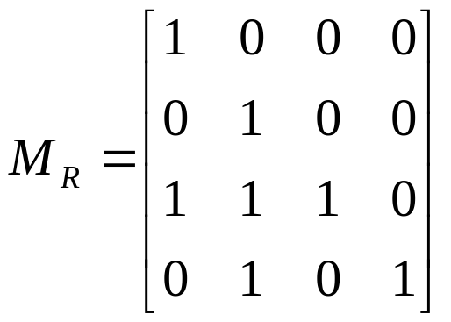
Example 11
Let A = {a, b, c, d}, and let R be the relation on A that has the matrix (given below)
Construct the digraph of R, and list in-degrees and out-degrees of all vertices.

Slide 33

 | a | b | c | d
In-degree | 2 | 3 | 1 | 1
Out-degree | 1 | 1 | 3 | 2
b
a
c
d

Slide 34

Let A = {1, 4, 5} and let R be given by the digraph shown below. list in-degrees and out-degrees of all vertices.
1
4
5

Slide 35
Reflexive Relations
Reflexive
  A Relation R on set A is called reflexive if every a∈A is related to itself OR
  A relation R on a set X is called reflexive if all pair (x,x)∈R; ∀x:x∈X
Irreflexive
  A relation R on a set A is irreflexive if xRx or (x,x)∉R; ∀x:x∈X
Not Reflexive
  A Relation R is not reflexive if at least one pair of (x,x)∈R, ∀x:x∈X

Slide 36

The relation R on X = {1, 2, 3, 4} defined by (x,y)∈R if x≤y, x,y∈X is a reflexive relation.
For each element x∈X, (x,x)∈R
(1,1), (2,2), (3,3), (4,4) are each in R.
The relation R = {(a,a), (b,c), (c,b), (d,d)} on X={a, b, c, d} is not reflexive.
This is because b∈X, but (b,b)∉R . Also c∈X, but (c,c)∉R

Slide 37
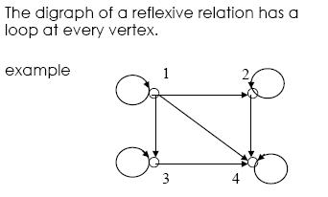
Reflexive Relations

Slide 38
Reflexive Relations
1
2
Reflexive
3
4
1
2
Irreflexive
3
4
2
1
Not Reflexive
3
4

Slide 39
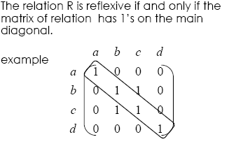
Reflexive Relations

Slide 40
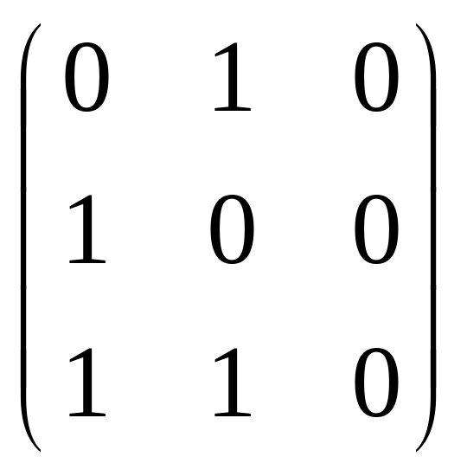
Reflexive Relations
The relation R is irreflexive if and only if the matrix relation have all 0’s on its main diagonal

Slide 41
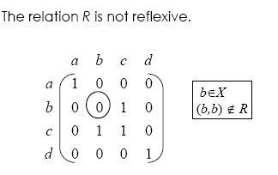
Reflexive Relations

Slide 42
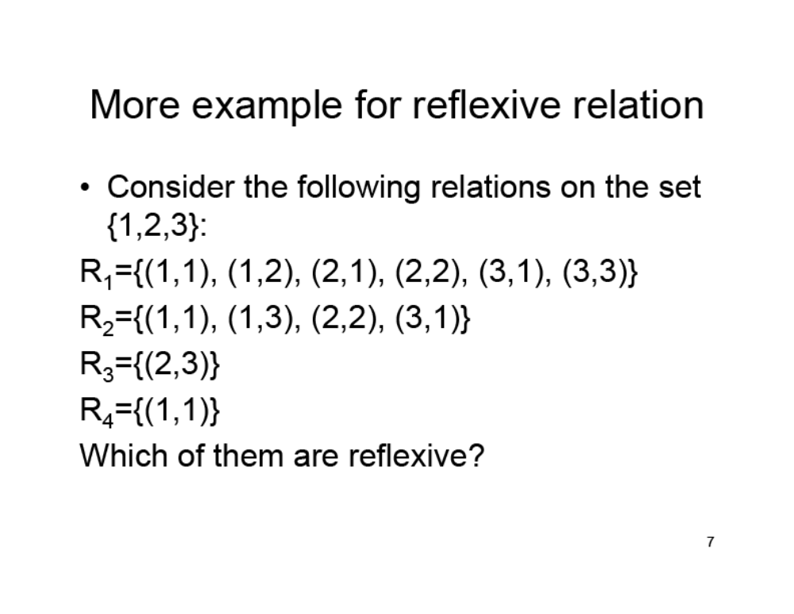
Exercise 8

Slide 43
Exercise 9
(i) Let R be the relation on X={1,2,3,4} defined by (x,y)∈R if x≤y, x,y∈X. Determine whether R is a reflexive relation.
(ii) The relation R on X={a,b,c,d} given by the below diagraph. Is R a reflexive relation?
a
b
d
c

Slide 44
Exercise 10
Let A = { 1,2,3,4). Construct the matrix of relation of R. Then, determine whether the relation is reflexive, not reflexive or irreflexive.
(i) R = { (1,1), (1,2), (2,1), (2,2), (3,3), (3,4), (4,3), (4,4))
(ii) R = { (1,3), (1,1), (3,1), (1,2), (3,3), (4,4)}
(iii) R ={ (1,2), (1,3), (3,1), (1,1), (3,3), (3,2), (1,4), (4,2), (3,4)}
(iv) R ={ (1,2), (1,3), (3,2), (1,4), (4,2), (3,4)}

Slide 45
Symmetric Relations
A relation R on a set X is called symmetric
if for all x,y∈X, if (x,y)∈R, then (y,x)∈R.
∀x,y ∈X, (x,y) ∈ R → (y,x) ∈ R
Let M be the matrix of relation R.
The relation R is symmetric if and only if
for all i and j, the ij-th entry of M is equal to the ji-th entry of M.

Slide 46

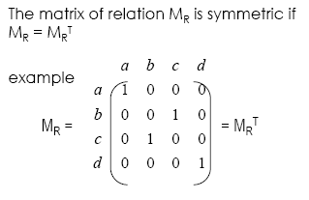

Slide 47
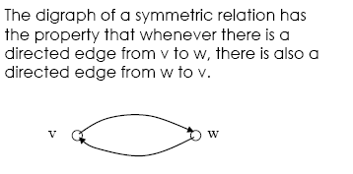

Slide 48

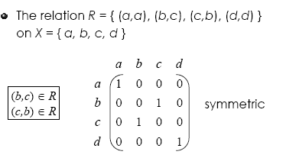

Slide 49
Antisymmetric
A relation R on set A is antisymmetric if a≠b, whenever aRb, then bRa. In other word if whenever aRb, then bRa then it implies that a=b
∀a,b ∈ A, (a,b) ∈ R ∧ a ≠ b → (b, a) ∉ R
Or
∀a,b ∈ A, (a,b) ∈ R ∧ (b, a) ∈ R → a = b

Slide 50
Antisymmetric Relations
Matrix MR = [Mij] of an antisymmetric relation R satisfies the property that if i≠j, then mij=0 or mji=0
If R is antisymmetric relation, then for different vertices i and j there cannot be an edge from vertex i to vertex j and an edge from vertex j to vertex i
At least one directed relation and one way

Slide 51
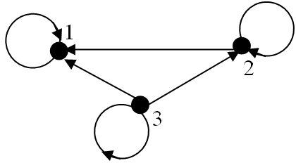
Example 14
Let R be a relation on A = {1, 2, 3} defined as (a, b) ∈ R if a ≥ b, a, b ∈ A is an antisymmetric relation because for all a, b ∈ A, (a, b) ∈ R and a ≠ b, then (b, a) ∉ R, for example
(3, 2) ∈ R but (2, 3) ∉ R
(3, 3) ∈ R and (3, 3) ∈ R implies a = b

Slide 52
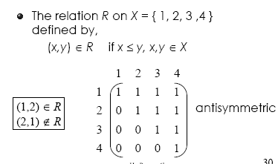
Example 15

Slide 53
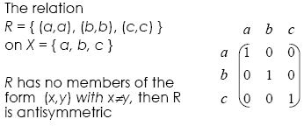
Example 16

Slide 54
Asymmetric
A relation is asymmetric if and only if it is both antisymmetric and irreflexive.
The matrix M_{R =} [m_{ij}] of an asymmetric relation R satisfies the property that
    If m_{ij} = 1 then m_{ji} = 0
    m_{ii} = 0 for all i (the main diagonal of matrix M_{R} consists entirely of 0’s or otherwise)

Slide 55
Digraph
If R is asymmetric relation, then the digraph of R cannot simultaneously have an edge from vertex i to vertex j and an edge from vertex j to vertex i
All edges are “one way street” and no loop at every vertex

Slide 56
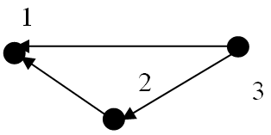
Example 17
Let R be the relation on A = {1, 2, 3} defined by (a, b) ∈ R if a > b, a,b∈A is an asymmetric relation because,
(2, 1) ∈ R but (1, 2) ∉ R
(3, 1) ∈ R but (1, 3) ∉ R
(3, 2) ∈ R but (2, 3) ∉ R
(1, 1) ∉ R, (2, 2) ∉ R, (3, 3) ∉ R

Slide 57
Not Symmetric
Let R be a relation on a set A. Then R is called not symmetric, if for all a, b ∈ A, if (a, b) ∈ R, there exist (b, a)∉R.
∃a,b ∈ A, (a, b) ∈ R → (b, a) ∉ R

Slide 58
Not Symmetric AND not antisymmetric
Let R be a relation on a set A. Then R is called not symmetric and not antisymmetric, if for all a, b ∈ A, if (a, b) ∈ R, there exist (b, a)∉R and if (a, b) ∈ R, there exist (b, a)∈R.
∃a,b ∈ A, (a, b) ∈ R → (b, a) ∈ R
AND
∃a,b ∈ A, (a, b) ∈ R → (b, a) ∉ R

Slide 59
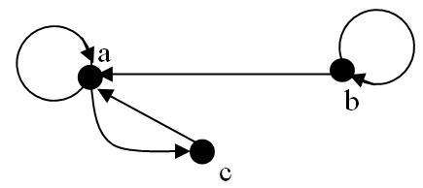
Example 18
Relation R = {(a, c), (b, b), (c, a), (b, a), (a, a)} on A = {a, b, c} is not symmetric and not antisymmetric relation because there is,
(a,c), (c,a) ∈ R and also (b,a) ∈ R but (a,b) ∉ R

Slide 60
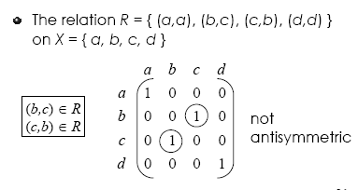
Example 19
Symmetric

Slide 61
Example 20
Let A=Z, the set of integers and let R={(a,b)ϵA×A| a<b}. So that R is the relation “less than”.
Is R symmetric, asymmetric or antisymmetric?
2. Let A={1,2,3,4} and let R = {(1,2), (2,2), (3,4), (4,1)}
Determine whether R symmetric, asymmetric or antisymmetric.

Slide 62
Solution
Question 1
Symmetric : If a<b, then it is not true that b<a, so R is not symmetric
Assymetric : If a<b then b>a (b is greater than a), so R is assymetric
Antisymmetric : If aǂb, then either a>b or b>a, so R is antisymmetric
Question 2
R is not symmetric since (1,2)∈R, but (2,1)∉R
R is not asymmetric , since (2,2)∈R
R is antisymmetric, since aǂb, either (a,b)∉R or (b,a)∉R

Slide 63

a
Symmetric
b
d
a
c
Not Symmetric and not Antisymmetric
b
d
c
a
b
Antisymmetric
d
a
Asymmetric
b
c
d
c

Slide 64
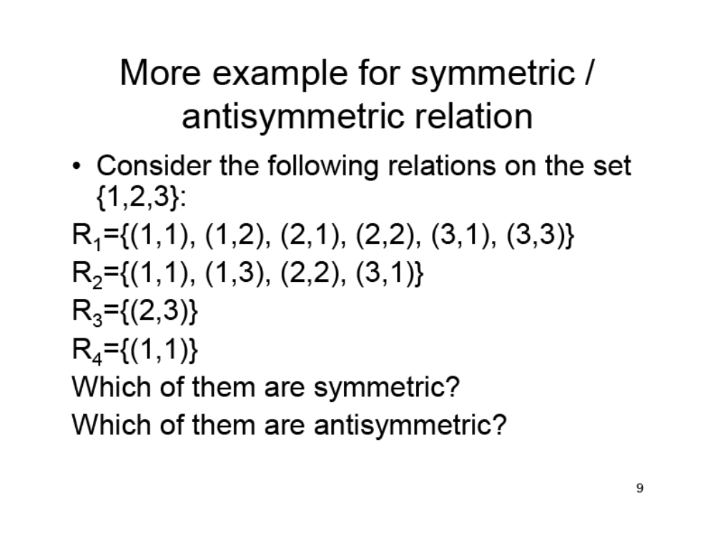
Exercise 14

Slide 65
Exercise 15
Let A = { 1,2,3,4). Construct the matrix of relation of R. Then, determine whether the relation is symmetric, assymetric, antisymmetric, not symmetric or not antisymmetric.
(i) R = { (1,1), (1,2), (2,1), (2,2), (3,3), (3,4), (4,3), (4,4))
(ii) R = { (1,3), (1,1), (3,1), (1,2), (3,3), (4,4)}
(iii) R ={ (1,2), (1,3), (1,1), (3,3), (3,2), (1,4), (4,2), (3,4)}

Slide 66
Transitive Relations
A relation R on set A is transitive if for all a,b∈A, (a,b)∈R and (b,c)∈R implies that (a,c)∈R
In the diagraph of R, R is a transitive relation if and only if there is a directed edge from one vertex a to another vertex b, an if there exits a directed edge from vertex b to vertex c, then there must exists a directed edge from a to c

Slide 67
Example 21
R={(1,1), (1,2), (1,3), (2,2), (2,3), (3,3)}
The diagraph:
1
2
3

Slide 68
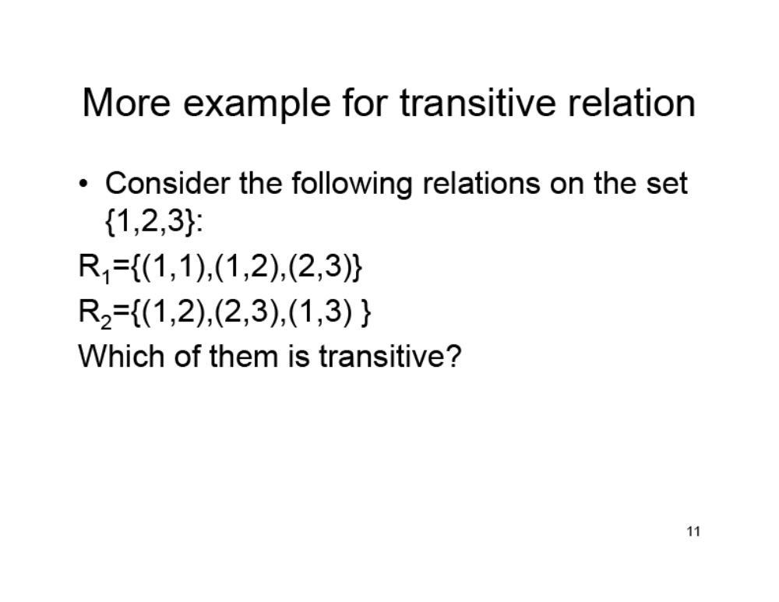
Exercise 16

Slide 69



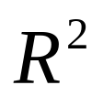


Transitive Relations
The relation R on a set A is transitive if an only if .
Every element of R² is an element of R
If then
The matrix of the relation M_{R} of
is the product of boolean

Slide 70
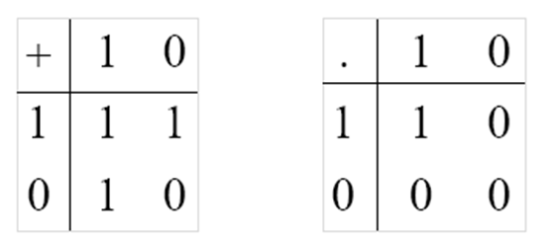
Boolean Algebra

Slide 71
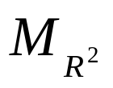
The matrix M_{R =} [m_{ij}] and =[n_{ij}]
The relation R on a set A is transitive
    If n_{ij} = 1 then m_{ij} = 1

Slide 72
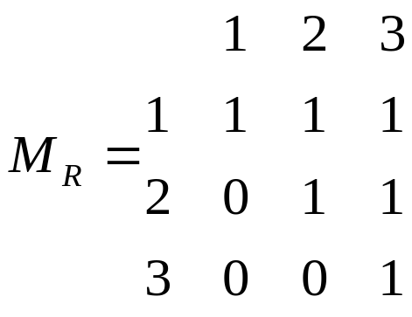
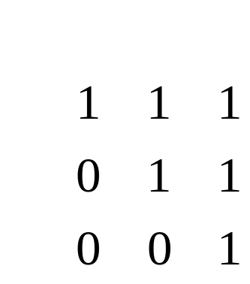
Example 22
The relation R on A={1,2,3} defined by (a,b)∈R if a≤b, a,b∈A, is a transitive. The matrix of relation M_{R,}
_{The product of boolean,}
Note that,(1,2) and (2,3)∈R, (1,3)∈R² and (1,3) ∈R.Thus
⊗
=

Slide 73
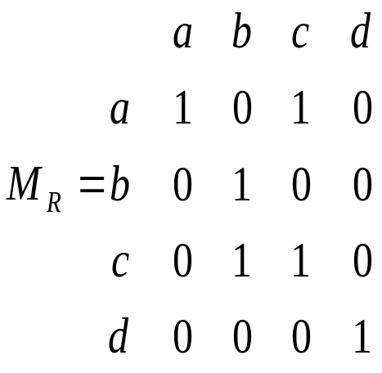
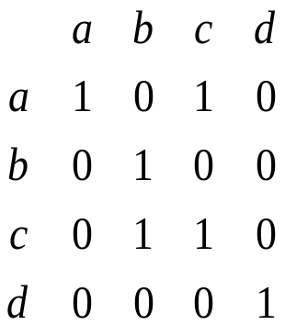
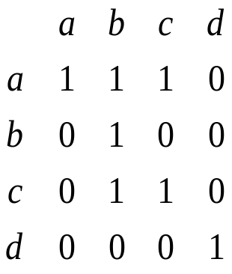
Example 23
The relation R on A={a,b,c,d} IS r={(a,a), (b,b), (c,c), (d,d), (a,c), (c,b)} is not transitive. The matrix of relation M_{R,}
_{The product of boolean,}
Note that,(a,c) and (c,b)∈R, (a,b)∈R² but (a,b)∉R.Thus R² is not a subset of R and the relation is not tansitive
⊗
=

Slide 74
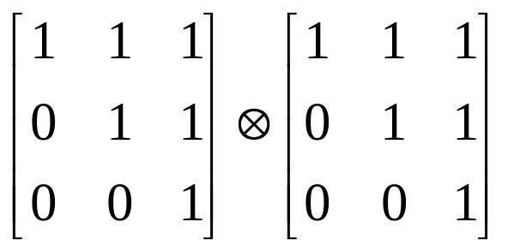
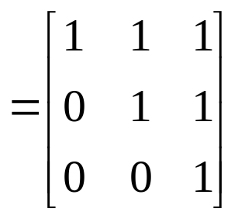
Example 24
Let R be a relation on A={1,2,3} is defined by (a,b)∈R if a≤b, a,b∈A. Find R. Is R a transitive relation?
Solution:
R={(1,1), (1,2), (1,3), (2,2), (2,3), (3,3)}
R is a transitive relation because
(1,2) and (2,2)∈R, (1,2)∈R
(1,2) and (2,3)∈R, (1,3)∈R
(1,3) and (3,3)∈R, (1,3)∈R
(2,2) and (2,3)∈R, (2,3)∈R
(2,3) and (3,3)∈R, (2,3)∈R

Slide 75
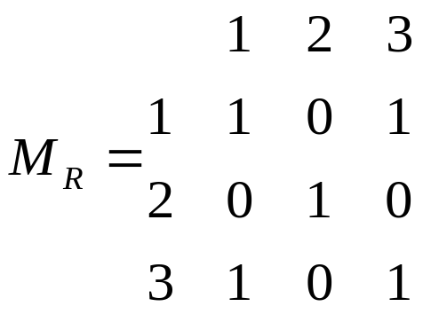
Equivalence Relations
Relation R on set A is called an equivalence relation if it is a reflexive, symmetric and transitive.
Example 25
Let R={(1,1), (1,3), (2,2), (3,1), (3,3)} on {1,2,3}, the matirx of the relation M_{R},
All the main diagonal matrix elements are 1 and the matris is reflexive.

Slide 76

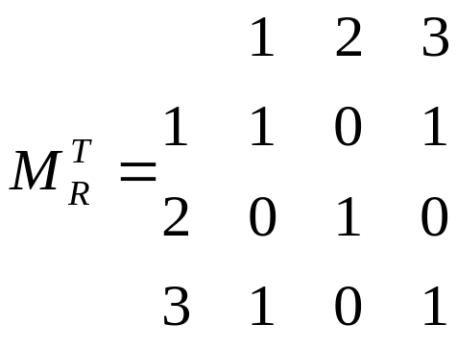
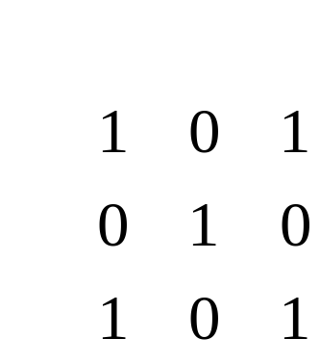
Equivalence Relations
Example 25(Cont.)
The transpose matrix M_{R}, is equal to M_{R}, so R is symmetric
The product of boolean show that the matrix is transitive.
⊗
=

Slide 77
Partial Order Relations
Relation R on set A is called a partial order relation if it is a reflexive, antisymmetric and transitive.
Example 26
Let R be a relation on a set A={1,2,3} defined by (a,b)∈R if a≤b, a,b∈R.
R={(1,1), (1,2), (1,3), (2,2), (2,3), (3,3)}
R is reflexive, antisymmetric and transitive.
So R is a partial order relation.

Slide 78
Exercise 17
The relation R on the set {1,2,3,4,5} defined by the rule (x,y)∈R if x+y≤6
(i) List the elements of R
(ii) Find the domain of R
(iii) Find the range of R
(iv) Is the relation of R refelxive, symmetric, assymmetric, antisymmetric, transitive, and/or equivalence relation or partial order?

Slide 79
Exercise 18
The relation R on the set {1,2,3,4,5} defined by the rule (x,y)∈R if 3 divides x-y
(i) List the elements of R
(ii) Find the domain of R
(iii) Find the range of R
(iv) Is the relation of R refelxive, symmetric, assymmetric, antisymmetric, transitive, and/or equivalence relation or partial order?

Slide 80
Exercise 19
The relation R on the set {1,2,3,4,5} defined by the rule (x,y)∈R if x=y-1
(i) List the elements of R
(ii) Find the domain of R
(iii) Find the range of R
(iv) Is the relation of R refelxive, symmetric, assymmetric, antisymmetric, transitive, and/or equivalence relation or partial order?

